Slide 1
Oral Defense Suggestions
The Oral Defense should be 20 – 30 minutes in length and will be with the Student, Chair, and 2nd Committee member.
Use graphics pertinent to the topic – see following three examples.
Proof and edit slides
Use same font and background on each slide
Check for professional appearance, flow, and unity throughout the presentation
Do not overuse color as it can be distracting
Do not read your slides to the committee
Use bullets with phrases and key terms
Discuss the main points using your slides as a guide

Slide 2
Graphic Suggestion
Consider adding a related photo, graphic, or using SmartArt

Slide 3

Graphic Suggestion
Power Points should have minimal verbiage…
5 short (1-2) word bullets max, or
two short sentences.
Discuss and elaborate using your notes
Key Points
Max 5 Short Pts.
Max 2 Sentences

Slide 4
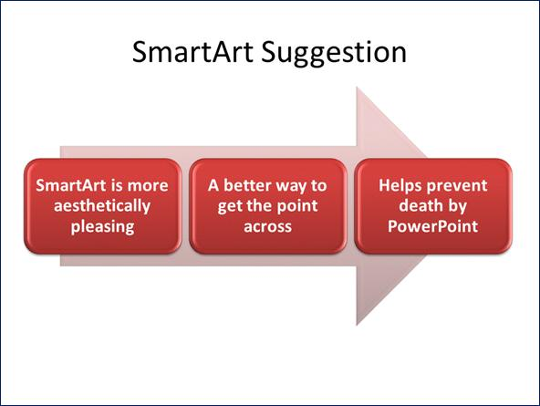

Slide 5
Click to add project title here
Student Name
Doctoral Study Oral Defense
DSW Capstone Project Final defense

Slide 6
Thank each faculty member by name
Chair:
2nd Committee Member:
URR:
Program Director:

Slide 7
Final Doctoral Study Defense
Provide key points from first proposal defense.
Then continue with next slides.

Slide 8
Section 3: Analysis of the Findings
List each research question as findings are based on evidence collected

Slide 9
How do findings relate to the literature

Slide 10
How do findings relate to theoretical framework

Slide 11
Section 4: Recommended Solutions

Slide 12
How do findings relate to professional social work practice

Slide 13
What implications do the findings have for social change

Slide 14
Section 4: Recommendations for action
Who will benefit from the results of this study
How can results be disseminated to the larger population (conferences, literature, etc.)

Slide 15
Thank you and questions
Chair: Dr.
2nd committee member: Dr.
URR: Dr.
Questions?

